Slide 1
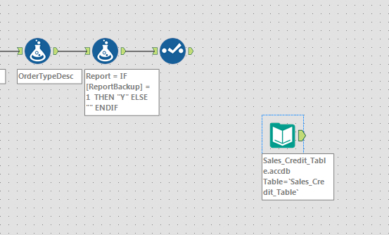
This is my Alteryx Results.
I want to Append the fields
Into the Microsoft Table below.
I need a way to map the fields
and append each line from Alteryx
as a new record.

