Slide 1

Your logo here
Untitled mission
Presented by Peter Gamble-Beresford

Slide 2
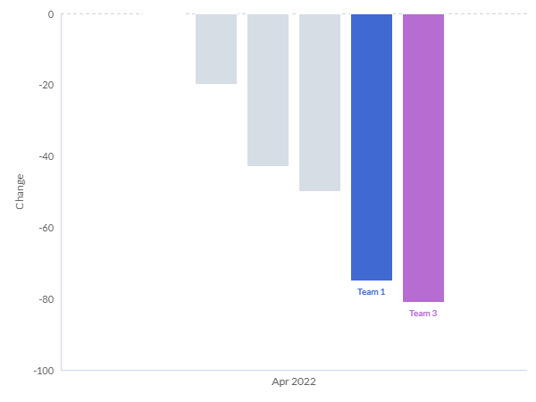
Diving into the Decrease: Analyzing Team 4's Call Count
Team 4 experienced a decrease of 269 calls in April 2022 compared to March 2022
Team 3 and Team 1 had the largest decrease contributing most to the overall drop
Most teams showed a decrease, while Team 6 remained stable
Recommendation: Implement targeted training for Teams 1 and 3 to boost call volume
Source: Alteryx Auto Insights
Notes:
In April, we observed a significant drop in the number of calls handled by Team 4. This drop was mainly driven by Teams 1 and 3, which experienced the most dramatic decreases. While most of our teams decreased their call volume, Team 6 was able to maintain their performance. To counter this trend, I suggest we implement targeted training programs for Teams 1 and 3 to boost their call volume.

Slide 3
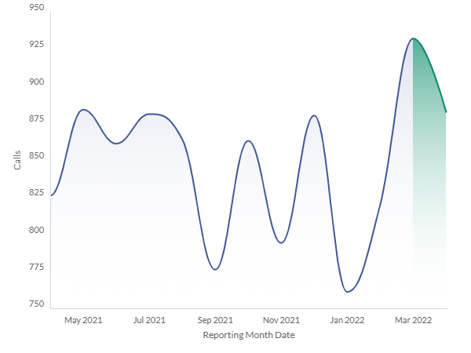
Unraveling the Reduction: Dissecting Team 4's Call Trend
Team 4's calls decreased by 50 in April 2022
Significant decrease was seen in early morning calls and with Brand A
Support Issue calls and calls handled by Agent Erminia Billinge also decreased
Recommendation: Increase focus on early morning calls and calls related to Brand A
Source: Alteryx Auto Insights
Notes:
In our analysis of Team 4's call trend, we identified a decrease of 50 calls in April. Notably, this decrease was particularly pronounced in the early morning time slot and with calls related to Brand A. We also saw a decrease in Support Issue calls and calls handled by agent Erminia Billinge. To address this, we should focus our efforts on improving early morning call response and handling Brand A related calls.

Slide 4
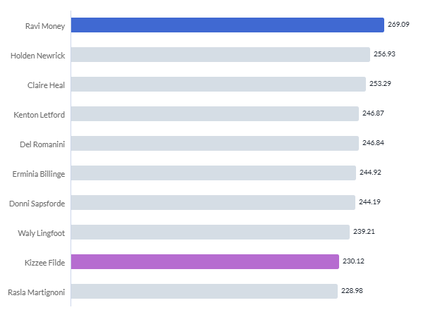
Dissecting the Details: Team 4's Agent Handling Time
Team 4's average handling time in April 2022 was 246.32
Ravi Money had the highest average handling time
Kizzee Filde had a below average handling time
Recommendation: Provide additional support for Ravi Money to improve handling time
Source: Alteryx Auto Insights
Notes:
Team 4's average handling time for April was 246.32. Our agent Ravi Money had the highest average handling time compared to the team average. On the flip side, Kizzee Filde showed a handling time below the team average. To improve our overall handling time, we could provide additional support and training to Ravi Money.

