Slide 1
Twin cities alteryx user group meeting
October 17th , 2019
WIFI: Industrious Guest
Enter Name and Email
(they won’t email you I swear)
Notes:
Fill in the city your group is located
Add the WIFI password

Slide 2
Welcome/Housekeeping items (TCAUG Leaders)
2019 Content Recap: the good, the bad, & the awesome.
Looking to 2020
Trivia!
Social & Doctor’s hours
Interested in presenting? Email nick612hayden@gmail.com

Slide 3

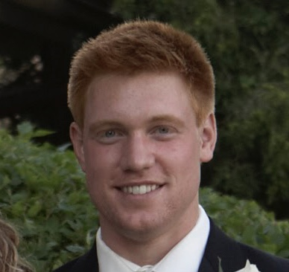
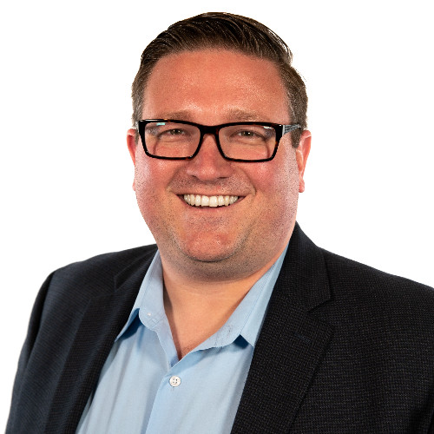
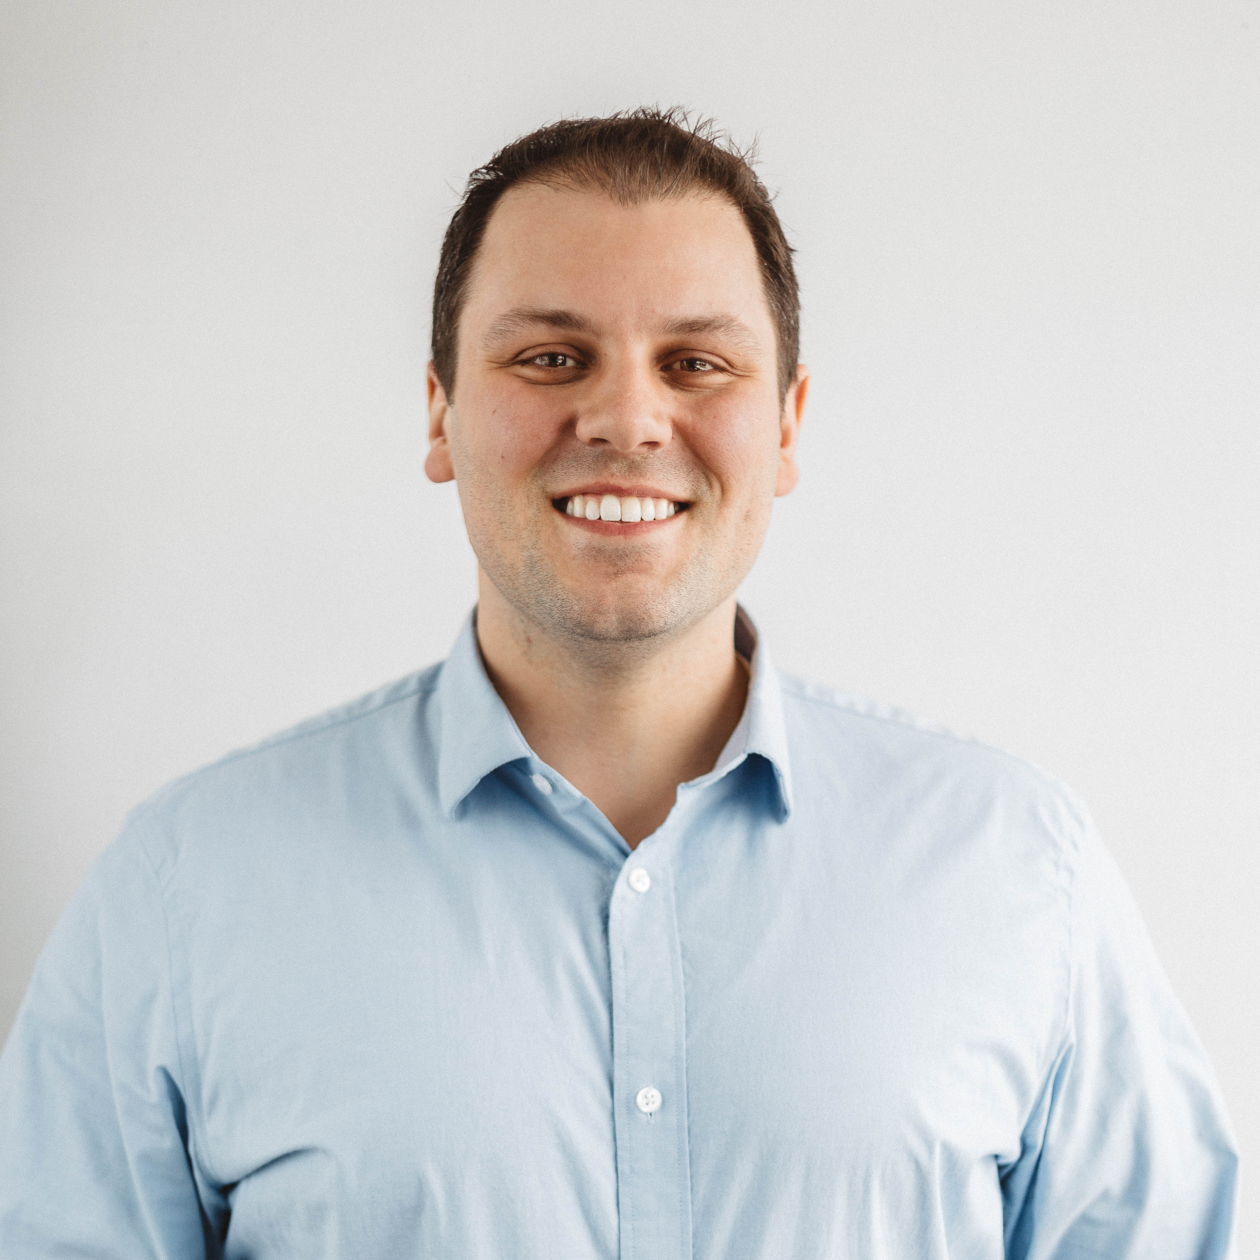


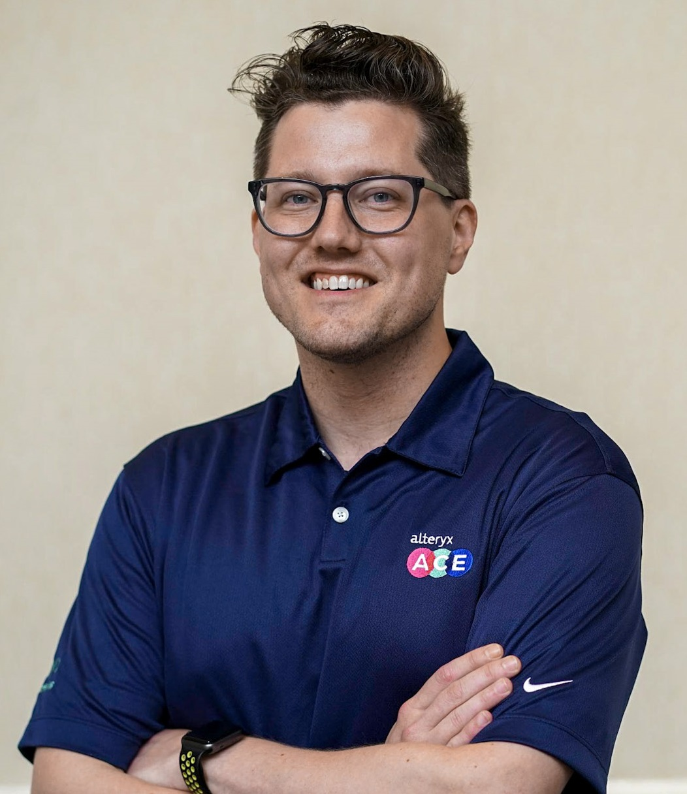
Twin cities Alteryx User Group: meet your 2019 leadership team
Aidan
Brad
Garth
Justin
Nick
Pedro
Tessa
Tessellation
DataDrive
Daugherty
Nerdery
nyxDATA
Haystack
Quest Diagnostics
©2019 Alteryx, Inc.

Slide 4

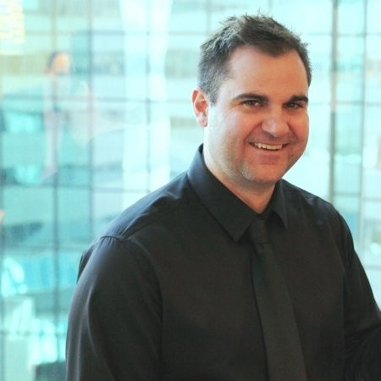
Twin cities Alteryx User Group: meet your local Alteryx execs
Dan
Nick
Alteryx
Alteryx
©2018 Alteryx, Inc.

Slide 5
ALTERYX COMMUNITY
UPDATES
*This meeting is being recorded and will be shared on the User Group page.

Slide 6
2019.4 NOW AVAILA-BLE
Input .hyper files
Copy and paste rows from excel to create an input tool
Mapbox integration
Find tool

Slide 7
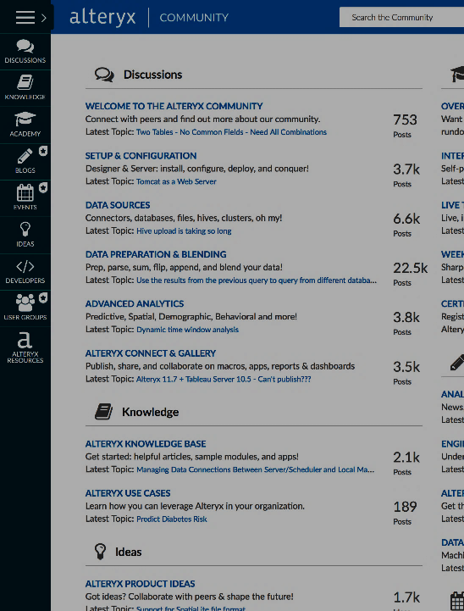




sign in. geek out.
Community.alteryx.com
Find answers quickly
Share your knowledge
Connect with peers
Discover new Alteryx use cases
Submit your bright ideas
Read insightful blogs
Develop tools, macros, and apps
*This meeting is being recorded and will be shared on the User Group page.
Notes:
If you have not signed up with Alteryx community just yet, i would recommend you to do so asap!
New data science blog is available – focuses on machine learning & data science.
Women of analytics group has been launched
For localization – French, German and Japanese are LIVE

Slide 8


Knowl-edge is power
Alteryx academy
Interactive lessons
Live training
Weekly challenges
Product certification – Now on demand!
community.alteryx.com/training
*This meeting is being recorded and will be shared on the User Group page.
Notes:
The Alteryx academy is where you’ll want to spend time to jump into:
• Interactive lessons - help you learn how to use the platform
• Live training - are instructor-led training sessions which focus on practical use cases to illustrate how to use tools and construct an analytical solution
• Weekly challenges - help you put your knowledge to the test. Share answers and collaborate with other challengers.
• Certification program (FREE) - test your proficiency.
March 8th the Alteryx designer core and Alteryx designer advanced exams will be available on-demand on community!
3 exam attempts each calendar month.
The new process spaces out attempts and allows customers to take the exam once every 7 days.
requires customers to be logged into their Community account to take an exam.

Slide 9
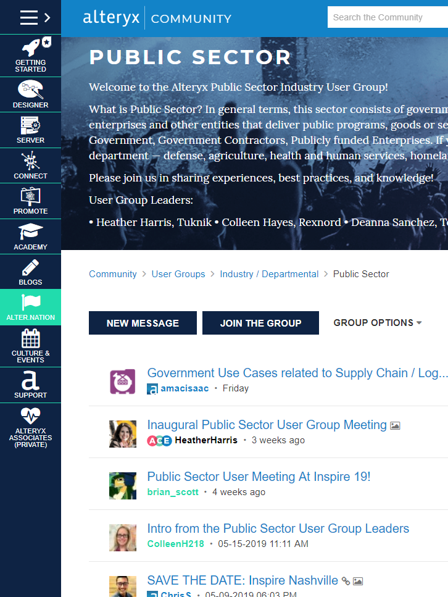
Industry
Departmental
User Groups
MEET
VIRTUAL
Join & subscribe
Customer use cases
Alteryx scalability
Follow discussions
Post on the page
Contact for more details:
cshernaman@alteryx.com
*This meeting is being recorded and will be shared on the User Group page.
Notes:
Meet virtually
Meetings are recorded and held on Webex
Customer use cases
Hear how people are using Alteryx in your industry
Alteryx scalability
Learn how organizations have scaled Alteryx within their Companies
Learn new tips and tricks
Follow Discussions
Top Challenges in data & analytics: (what are those?)
Topics: (name a few going on that are relevant)
Post on the page
Have your members use the User Group page like their own personal blog

Slide 10
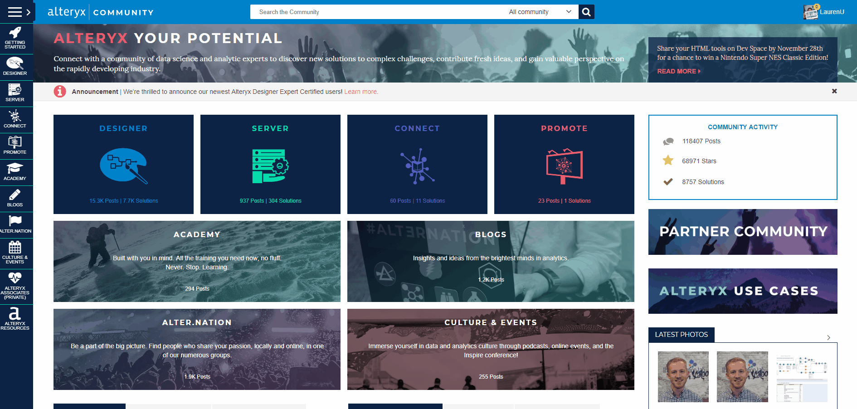
Meeting Round UP
Catch up on missed meetings!
Share content with colleagues!
Discover what other User Groups are up to!
*This meeting is being recorded and will be shared on the User Group page.
Notes:
The meeting round up can be found on the community in the Alteryx user group section near the top right.
Take a look at past user group meetings (industry/departmental and local groups), learn what other user groups are doing and hear more use cases!

Slide 11
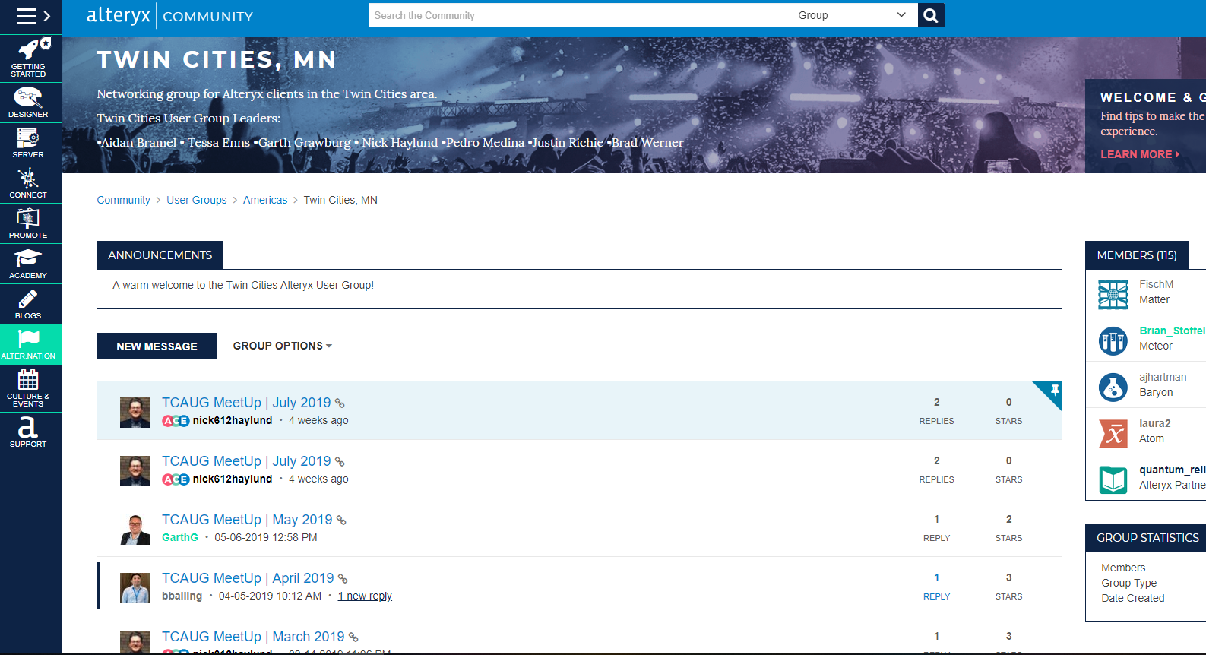
https://community.alteryx.com/t5/Twin-Cities-MN/gp-p/twin-cities
Notes:
Take a screen shot of your User Group page and walk your members through a short demo (2 min)

Slide 12

DIGIAL MAGAZINE ABOUT DATA SCIENCE + ANALYTICS
INPUT IS LIVE.

Slide 13
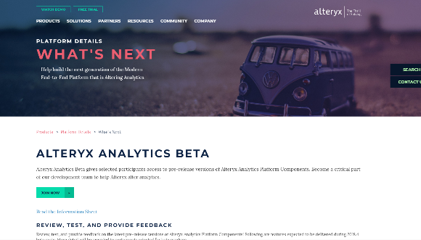
Alteryx Analytics beta program
Review, test, and provide feedback
Become a critical part of our development team!
Try the latest features and give feedback to help Alteryx deliver the best versions of our product!
Join now: https://community.alteryx.com/t5/Join-Beta-Program/tkb-p/beta-programs
*This meeting is being recorded and will be shared on the User Group page.
Notes:
https://www.alteryx.com/products/platform-details/whats-next
https://community.alteryx.com/t5/Join-Beta-Program/tkb-p/beta-programs
Review, test, and provide feedback on the latest pre-release versions of alteryx analytics platform components! Following are features expected to be delivered during 2019.1 beta cycle. More detail will be provided to participants selected for the beta program.
Connect
Enable data classification
Designer
UI reskin
Interactive results grid
Driver manager
Assisted modeling
Server
Designer integration
New server admin experience

Slide 14

A podcast about data science and analytics culture
community.alteryx.com/podcast
*This meeting is being recorded and will be shared on the User Group page.
Notes:
Found under “Culture & Events” on Community
We’re kicking off a series of episodes that were recorded in Nashville Tennessee at the annual Alteryx Inspire conference. For our first episode in the series, we’re joined by Julia Cole, Nashville Recording Artist at CAA Creative Artists Agency for a chat about the inner workings of being a country music artist in Nashville and her Women’s Sports Social movement. Stay tuned for more!

Slide 15
Meeting Round Up is live!
Catch up on missed meetings!
Share content with colleagues!
Discover what other User Groups are up to!

Slide 16
Alteryx Analytics beta program
Review, test, and provide feedback
Become a critical part of our development team!
Try the latest features and give feedback to help Alteryx deliver the best versions of our product!
Join now: https://community.alteryx.com/t5/Join-Beta-Program/tkb-p/beta-programs
Notes:
https://www.alteryx.com/products/platform-details/whats-next
https://community.alteryx.com/t5/Join-Beta-Program/tkb-p/beta-programs

Slide 17

2019 Content
What was the Twin Cities Alteryx User Group up to this year?
COMMUNITY.ALTERYX.COM/PODCAST

Slide 18
Analytics day @Slalom
March
Alteryx Roadmap & Platform Demo with Ashley Kramer (Alteryx)
How to best utilize Alteryx Gallery, Connect and Promote.
Local customer keynotes: hear from company leaders from around the Twin Cities talk about successes with Alteryx and self service analytics!
Breakouts: analyst and leader tracks!

Slide 19
Show & tell
@ Slalom
February
Ben Balling of TransPerfect shows us how he makes the most of Alteryx Designer + Gallery for empowering self service!
Eleanna Goudey of Slalom talks Alteryx Connect: giving knowledge workers the power to discover and understand relevant data assets

Slide 20
python
@ Daugherty
May
Inspire Updates
Em Roach of Alteryx give us a deep dive on the Python tool
Alteryx Certification with Jim Van Sistine of Daugherty Business Solutions

Slide 21
Inspire ‘19
NASHVILLE, TN
June
Inspiring keynotes about doing good with data by Malcolm Gladwell!
User Groups session hosted by our very own Tessa Enns and Nick Haylund
Tips & Tricks
In depth training
Alteryx Platform Roadmap & demos
Networking

Slide 22
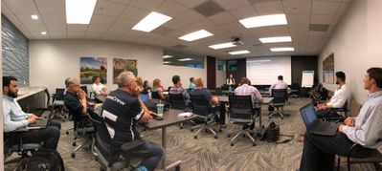
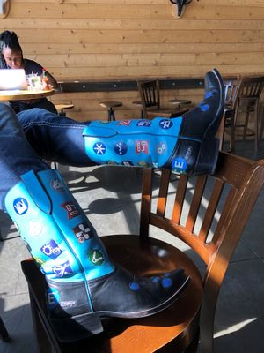
Geocoding +
@ DataDrive
July
Geocoding use case and walkthrough with Luke Komiskey of DataDrive!
Inspire ‘19 recap by Aidan Bramel
Plus some tips and input from extra special guest MarqueeCrew!

Slide 23
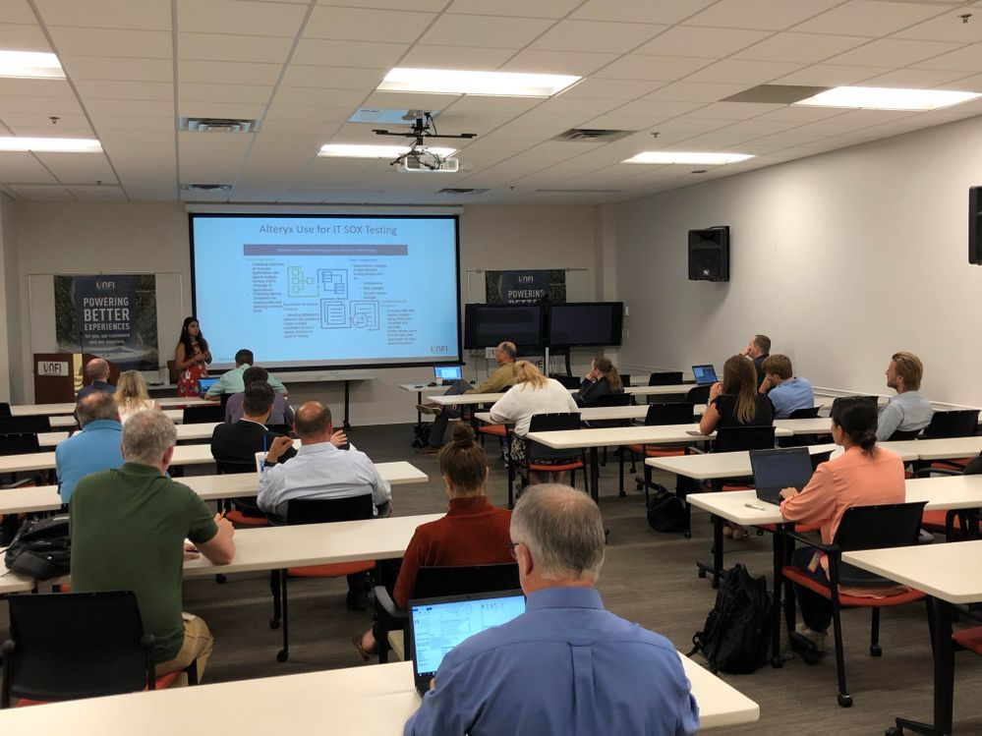
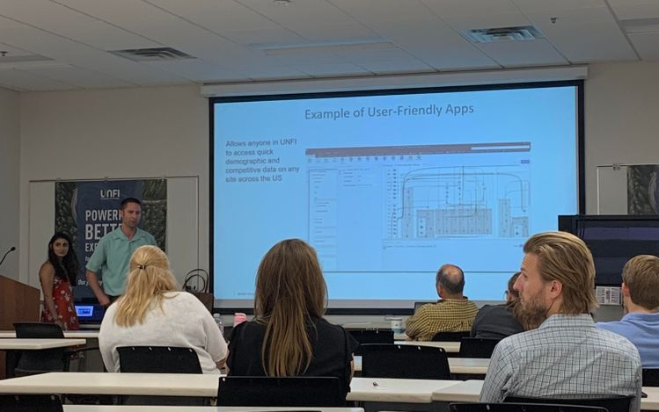
Case studies
@ UNIFI
August
Using Alteryx for Audit with Nageen Moghaddam and Greg Barnard of UNIFI
Nageen shows us her tips for using reporting tools for automation in her daily audits
Matt Siesennop takes Spatial Analytics to the next level using MapInfo and integrating self-service reports with Analytics Apps on Alteryx Server!

Slide 24
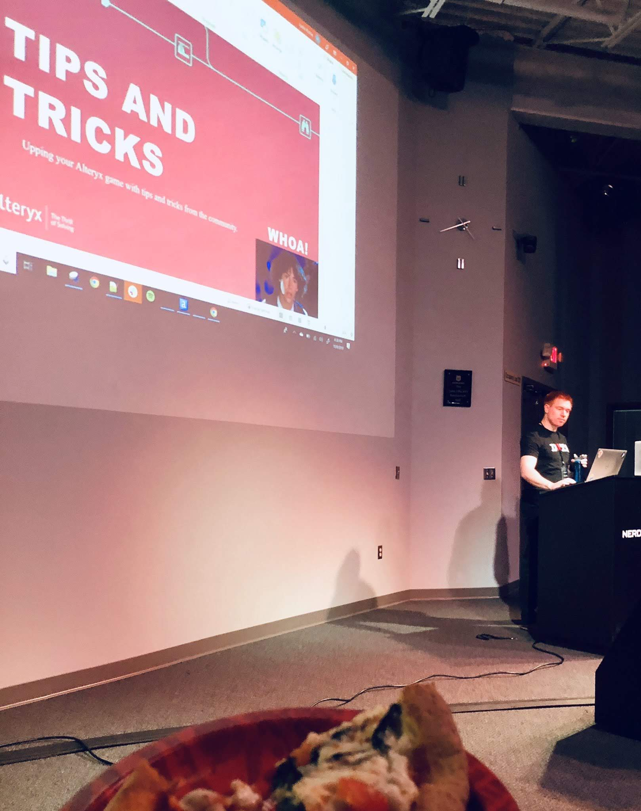
ADVANCED AYX
@ nerdery
October
Rolling table calculations in Alteryx? Justin Richie of Nerdery had us covered!
Justin also sampled his amazing data science skills by showing how he used this new data to feed into a model.
Tips & Tricks from the Alteryx Community featuring Brad Werner of Data Drive!

Slide 25
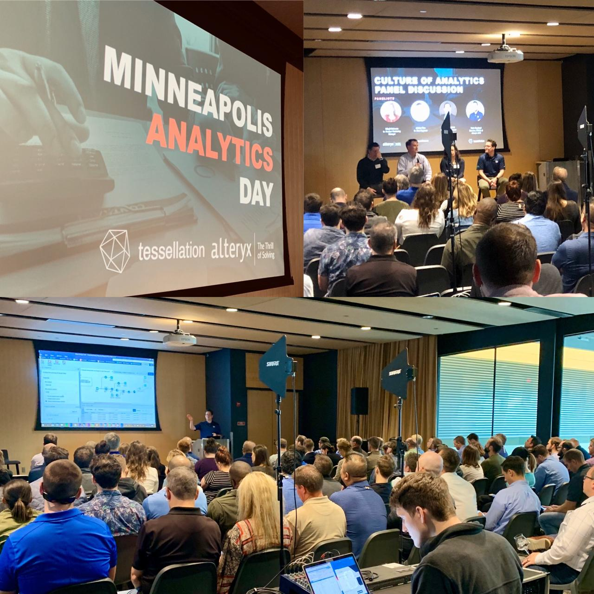
Analytics Day
@ Surly with Tessellation
October
Alteryx Designer demo by Alteryx
Alteryx Use Cases by ACE Nick Haylund!
Hands on Solution Center with Alteryx and Tessellation

Slide 26
WE DID A LOT.
BUT WE (as a community) CAN DO MORE…
COMMUNITY.ALTERYX.COM/PODCAST

Slide 27
Suggestion survey
2019
Content
Locations
Time
Frequency
Other?
COMMUNITY.ALTERYX.COM

Slide 28
Trivia!
Beverage break…come back in 10 minutes
COMMUNITY.ALTERYX.COM/PODCAST

Slide 29
10 questions
Raise your hand, must answer immediately.
COMMUNITY.ALTERYX.COM

Slide 30
How did alteryx get its name?
1 / 10
Answer
Alter – YX
SRC developed the first online data engine for delivering demographic-based mapping and reporting shortly after being founded (1997)
In 2006, the software product Alteryx was released, which was a unified spatial and non-spatial data environment for building analytical processes and applications.
In 2010, SRC changed its name to that of its core product, Alteryx.
COMMUNITY.ALTERYX.COM

Slide 31
What is the most current version of alteryx today?
2 / 10
Answer
2018.4
COMMUNITY.ALTERYX.COM

Slide 32
What language is the Alteryx engine written in?
3 / 10
Answer
C++
COMMUNITY.ALTERYX.COM

Slide 33
Name an Alteryx Easter egg, which you can unlock via the help menu
4 / 10
Answer
Space Invaders
Pong
COMMUNITY.ALTERYX.COM

Slide 34
Name a tool that accepts multiple inputs
5 / 10
Answer
Join, Union, Append Fields, Find Replace, Join Multiple, Spatial Match, Find Nearest, Report Map, Detour End, Test, Dynamic Rename, Dynamic Replace
COMMUNITY.ALTERYX.COM

Slide 35
Name a tool that has multiple outputs
6 / 10
Answer
Join, Filter, Spatial Match, FindNearest, Unique, Detour, Dynamic Replace
COMMUNITY.ALTERYX.COM

Slide 36
How many types of workflows are there?
7 / 10
Answer
3
COMMUNITY.ALTERYX.COM

Slide 37
Name them all
8 / 10
Answer
Standard
Analytical App
Macro
COMMUNITY.ALTERYX.COM

Slide 38
Name 3 macro types
9 / 10
Answer
Batch
Iterative
Standard
Bonus…
Location Optimizer
COMMUNITY.ALTERYX.COM

Slide 39
What is the limit for records read into alteryx?
10 / 10
Answer
No limit!
COMMUNITY.ALTERYX.COM

Slide 40

Happy hour
&
Doctor’s Hours thanks for a wonderful 2018 twin cities AUG!
Let us know what you want to see in 2019!

