Slide 1
Sydney Alteryx User Group
Q2 2023
15 June 2023
Nezrin Noushad
Ramesh Neelamanna

Slide 2
Welcome and Introductions Nez Noushad
Alteryx Community – Intro & Updates Nez Noushad
Soundbites from Alteryx Inspire, Las Vegas Elizabeth Gil
Alteryx Roadmap Leo Francia
Self-Service Analytic Apps with Alteryx and Snowflake Blake Lamond
Closing Ramesh Neelamanna

Slide 3
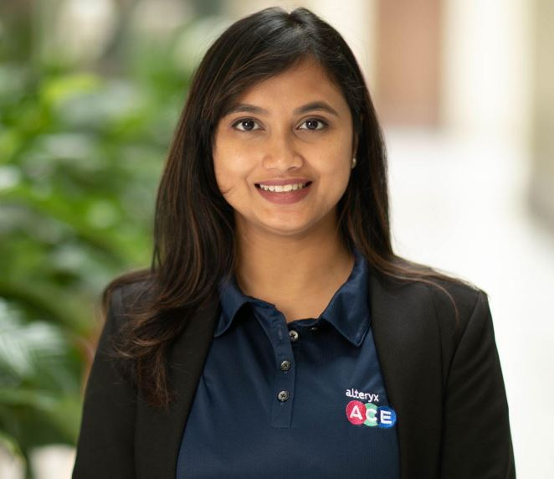
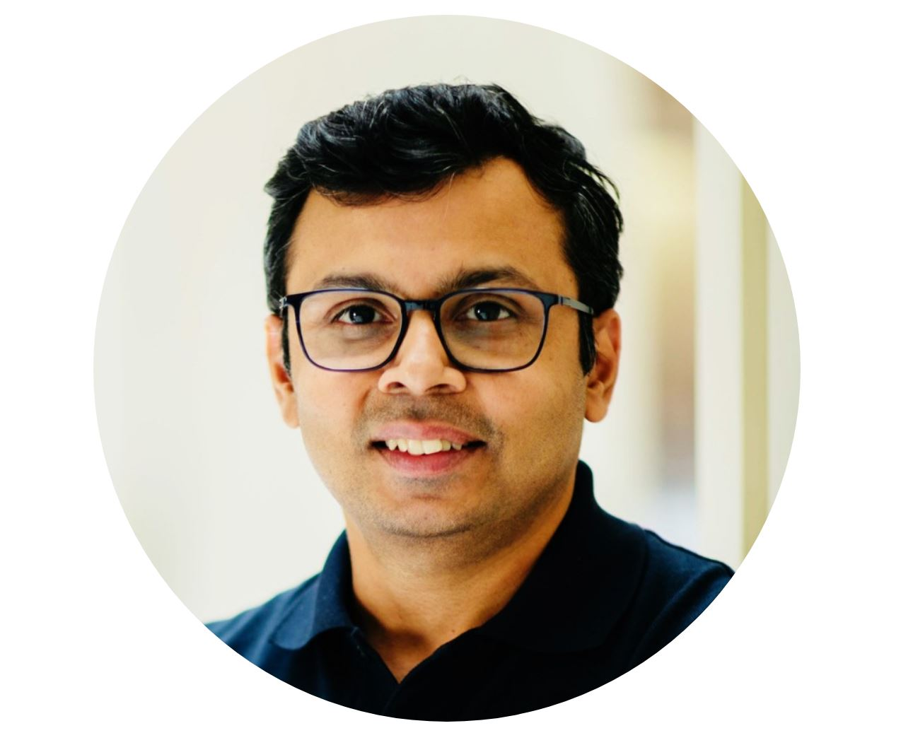
Sydney Alteryx User Group Leadership
Nezrin Noushad
Ramesh Neelamanna
  Alteryx ACE
  Alteryx Innovator

Slide 4
Alteryx Community Updates
June, 2023
Nezrin Noushad
Alteryx ACE

Slide 5
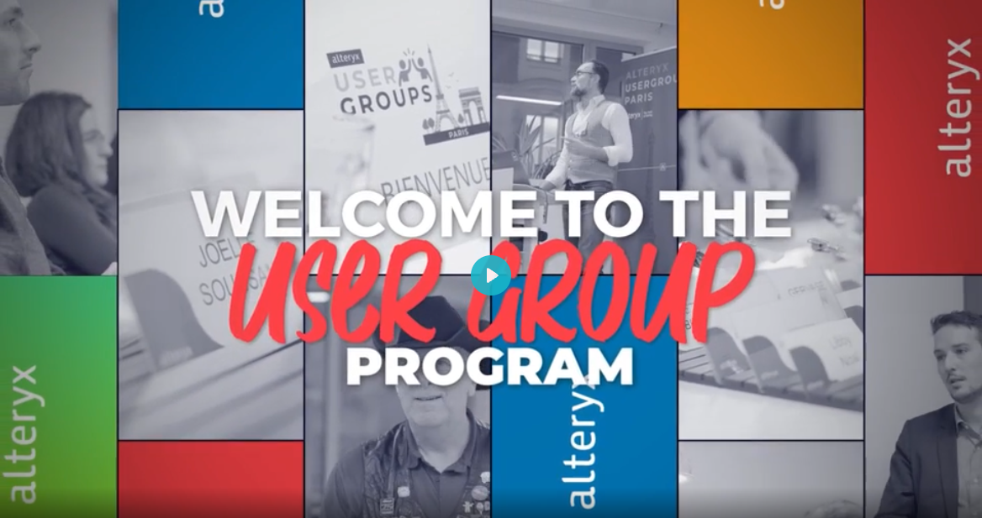
Promote the User Group Program in your Social Media Channels!
Download the video:
https://www.youtube.com/watch?v=Zoo5gEuVpPo

Slide 6
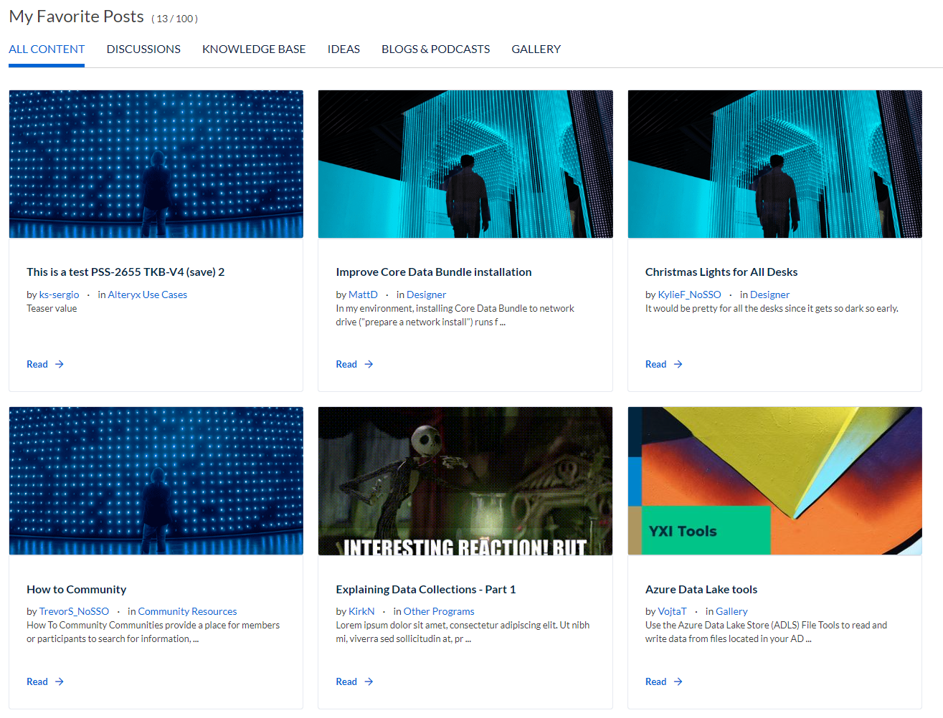
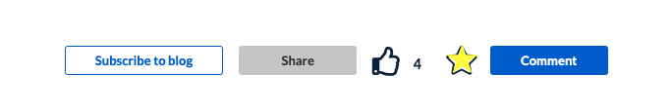
Updates to the user profile page!
With the recently updates, now the users have even more new features to enjoy!
Have you seen the Favorites functionality?
Now users have sorting capabilities when you have over 13 posts and can access the Favorites Post Page.
You can filter between All Content, Discussions, Ideas, Blogs & Podcasts, Knowledge Base and Gallery. Users can also now favorite replies on most board types, and the favorite button has been updated to a nice little star next to the likes.

Slide 7
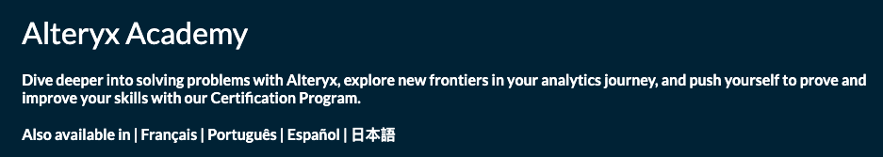
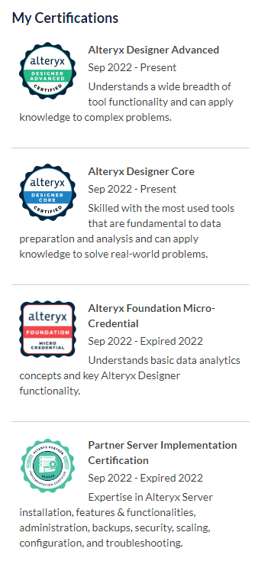
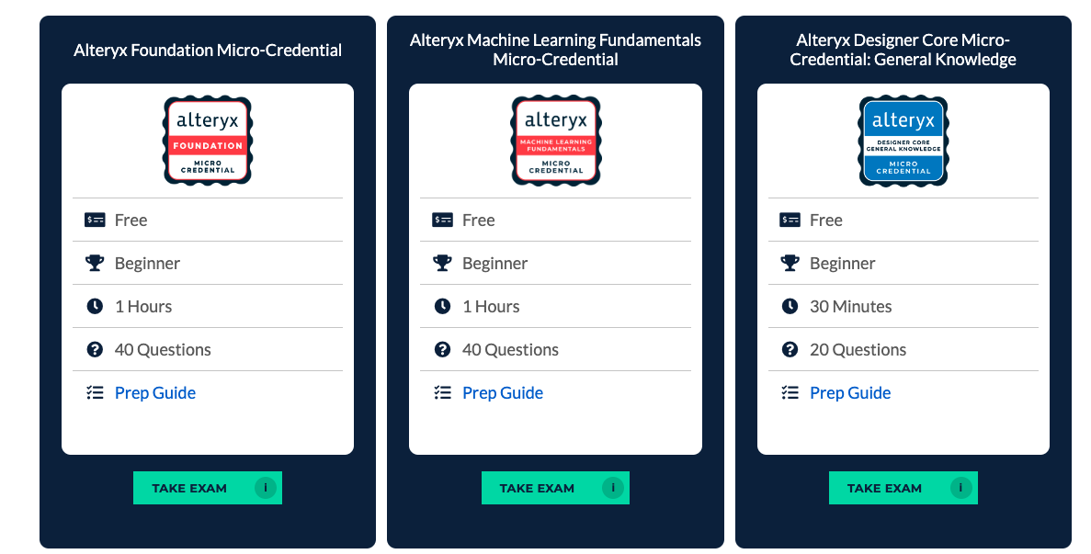
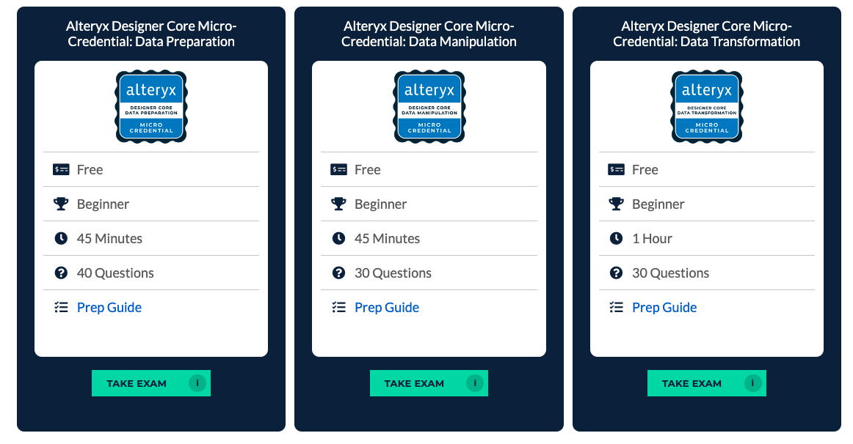
Micro-Credentials - Shortened form of certification that is designed to demonstrate competency in a specific area. They are available free and on demand.
  Machine Learning Fundamentals
  Alteryx Foundation
  Designer Core – Split in 4 short tests
  If you aren't ready to take the full Core exam, consider taking the Alteryx Designer Core Micro-Credential: General Knowledge test as an alternative first step towards achieving full Core certification. Once you pass all four of the Core micro-credentials, you earn full Core certification and are eligible to take the Advanced certification exam.
  Server Administration certification coming soon! Stay tuned for more information!
Instructor-LED Training - Real-time access to the instructor for feedback and discussion. Available to Alteryx customers via Alteryx Professional Services).
And the new certification system that displays user's current and past certifications, so they can share their achievements with other users via their profile page

Slide 8

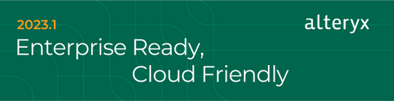

2023.1
If you haven't heard, we released the unified Alteryx Analytics Cloud Platform in February, and now we're thrilled to offer the newest version of the Alteryx Designer and Server portfolio that is cloud-connected. With our latest release, we're focusing on three key areas:
Capture more enterprise use cases
Manage workflows within your IT ecosystems, and
Ensure secure and governed access to more data than ever before
  Manage your Workflows with More Flexibility and Control
  Automate your Alteryx Server Processes with additional API Support
  Unlock Productivity with Enterprise Utility Kits
  Data Connectivity and Authentication
  Dark Mode Beta
  And more…

Slide 9










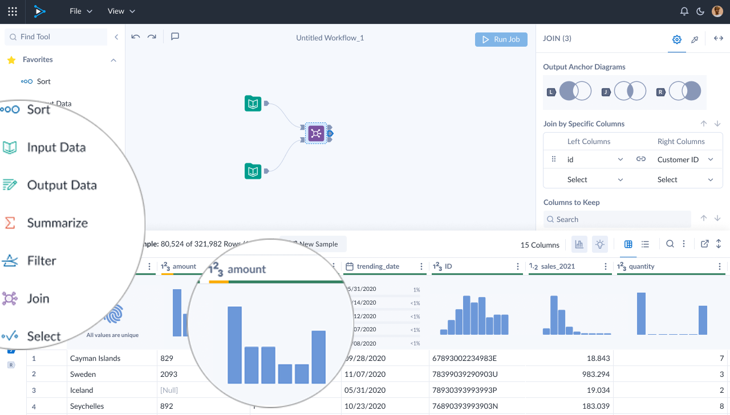

The best of
DESIGNER
TRIFACTA
Easy-to-Use & Self Service
No code / code friendly and accessible via any web browser
Interactive
AI/ML-based suggestions for exploration and transformation of data
Enterprise Grade
Scalable, secure, governed, optimized for cloud databases
Collaboratively prepare, transform, and enrich data while leveraging the cloud for scalable execution
Notes:
TALKING POINTS
Designer Cloud enables data engineers and analysts to collaboratively profile, prepare, and pipeline data for downstream analytics use cases.
With an AI-assisted, Interactive approach, Designer Cloud helps users accelerate data transformations and automate robust data pipelines in the cloud.
Now analysts of all skill levels can perform Self Service analytics and easily transform data, ensure data quality, and automate data pipelines at scale using a no-code/low-code visual user interface.
Comes with 100+ data connectors, multi-cloud pushdown optimization, multi-tenant, multi-region, VPC option, SOC certified and ISO in progress.
With a cloud solution, enable:
Broad Access to Analytics
Streamline IT management of Data & Analytics
Stay up to date with Immediate Access to Innovations

Slide 10
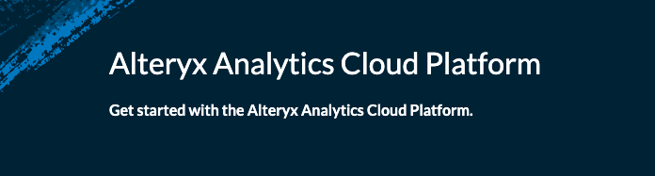
The new Alteryx Analytics Cloud Platform pages on Community pull together resources to get you the answers and training you need when working with our cloud products.
These pages contain video introductions, discussions, knowledge base articles, and additional resources to help you on your learning journey. And the Desginer Cloud page contains the all new Designer Cloud discussion forum so you can get your burning questions answered!
Community has a brand new product page for the Analytics Cloud Platform!
Check it out at: https://community.alteryx.com/t5/Alteryx-Analytics-Cloud-Platform/bd-p/analytics-cloud#all
Notes:
Cloud Platform: https://community.alteryx.com/t5/Alteryx-Analytics-Cloud-Platform/bd-p/analytics-cloud#all

Slide 11
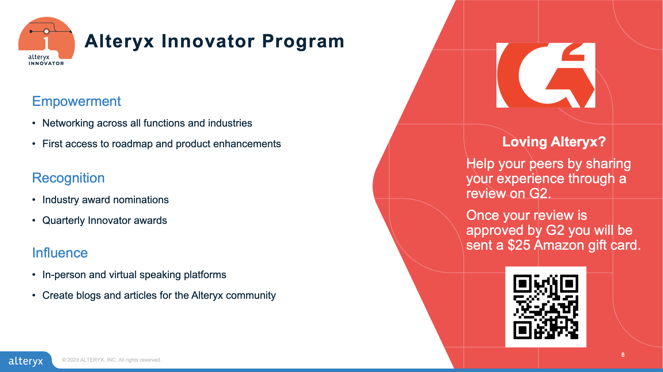

Slide 12




Free Alteryx Designer licenses, teaching materials, and learning paths.
Currently 500+ universities partners in 40 countries.
Data Analytics Automation for Education
Students
Educators
Career Changers
Software
Community network
Scholarships and Internships
Certifications and Job Board
Software
Teaching materials
Instructor-led or self-paced learning pathways
Community of Educators
Software
Self-paced learning
Community network
Certifications and Job Board
Available in English, French, German, Japanese, Portuguese, Spanish

Slide 13




Sydney
Tokyo
London
Amsterdam
Dubai
Watch On Demand
https://www.alteryx.com/inspire
https://www.alteryx.com/inspire/inspire-on-tour
Notes:
REGISTER: https://www.alteryx.com/inspire
Breakout Sessions: https://reg.rainfocus.com/flow/alteryx/inspire2023/sessioncatalog/page/sessioncatalog?_ga=2.236920193.141481882.1677514250-887800553.1667408802

Slide 14
Soundbites from Alteryx Inspire, Las Vegas
Elizabeth Gil
Global Account Executive, Alteryx
Notes:
Bryce kicks off with welcome and bio

Slide 15
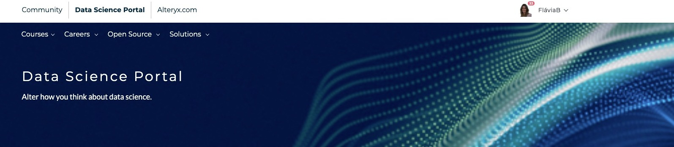
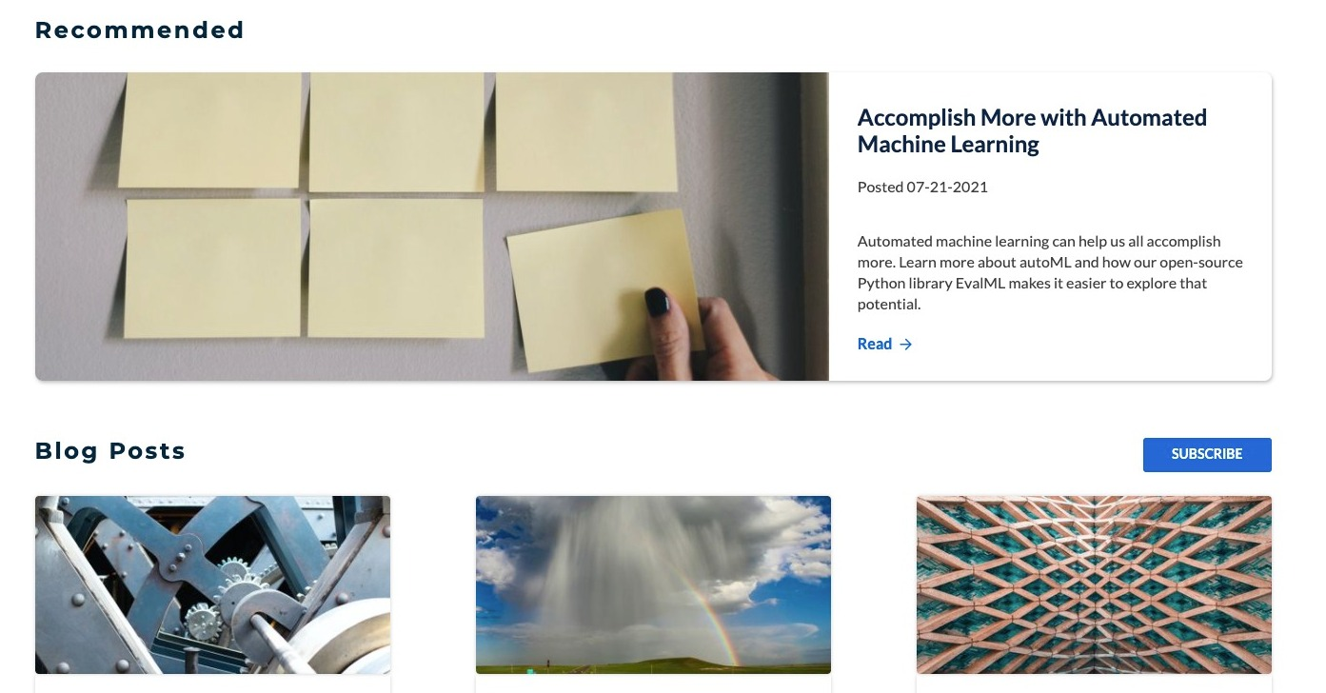
Alteryx Data Science Portal
For the data scientist, both current and aspiring!
Curated Community content that is data science focused
alteryx.com/data-science

Slide 16
Alteryx Product Roadmap
Leo Francia
Partner Sales Engineer, Alteryx
Notes:
Bryce kicks off with welcome and bio

Slide 17
Thrill Before Inspire: Unite & Ignite
Agenda for July 10
Registration
Welcome – Ramesh & Nez
Alteryx Road Map Update – Scott Anderson ( AYX)
How to be an ACE – Joshua Burkhow (AYX)
Q & A
Networking : Drinks and Canapes

Slide 18
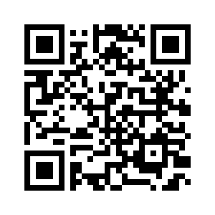
User Group Meeting Survey
Notes:
Survey link: https://survey3.medallia.com/?virtual-user-group

