Slide 1

Your logo here
Blog Views
Presented by Megan Dibble

Slide 2
Surge in Blog Views by Country
39.6% increase in visits compared to Q1 2022
USA contributed the most with an increase of 18,261 visits
102 countries increased views, 60 decreased, 3 remained stable
Recommend targeting high-growth countries for further expansion
Source: Alteryx Auto Insights
Notes:
In Q1 2023, we experienced an impressive 39.6% increase in blog views compared to the same period last year. The United States played a significant role, contributing an additional 18,261 visits. Out of 165 countries, we saw growth in 102, a decline in 60, and stability in 3. To capitalize on this momentum, we suggest focusing on high-growth countries for further expansion.

Slide 3
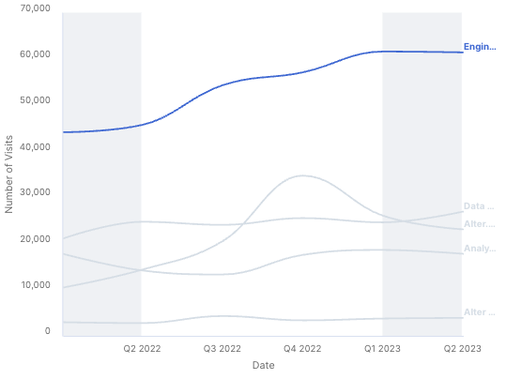
Board Titles Driving Blog View Growth
39.6% increase in visits compared to Q1 2022
Engine Works board saw the largest growth with 17,462 additional visits
All 5 board titles experienced an increase in views
Recommend promoting popular board titles to boost engagement
Source: Alteryx Auto Insights
Notes:
Our blog views saw a 39.6% increase in Q1 2023 compared to the previous year. The Engine Works board contributed the most, with an additional 17,462 visits. All five board titles experienced growth, indicating a strong performance across the board. We recommend promoting popular board titles further to continue boosting engagement.

Slide 4
Blog Topic Trends: What's Hot and What's Not
39.6% increase in visits compared to Q1 2022
883 new or returning conversation titles drove growth
1415 conversation titles increased, 743 decreased, 159 remained stable
Recommend analyzing top-performing topics for content strategy
Source: Alteryx Auto Insights
Notes:
In Q1 2023, blog views increased by 39.6% compared to the previous year. This growth was driven by 883 new or returning conversation titles. We observed that 1,415 conversation titles increased in views, 743 decreased, and 159 remained stable. To optimize our content strategy, we suggest analyzing top-performing topics and incorporating them into future content.

Slide 5
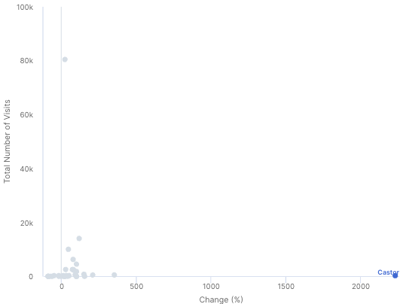
Community Rank Influence on Blog Views
39.29% increase in visits compared to Q1 2022
Castor community rank saw a fast percentage increase
Most community ranks increased, 11 decreased, Pulsar remained stable
Recommend engaging high-contributing community ranks for sustained growth
Source: Alteryx Auto Insights
Notes:
In Q1 2023, blog views experienced a 39.29% increase compared to Q1 2022. The Castor community rank contributed significantly to this growth with a fast percentage increase in views. Most community ranks saw an increase, while 11 decreased, and Pulsar remained stable. To maintain this growth, we recommend engaging with high-contributing community ranks and encouraging their continued participation.

